Slide 1
FuelMart & Subway Safety Committee Meeting
Wednesday, March 20, 2019
2:00 PM
Corporate Office Conference Room and GoTo Meeting Web Conference

Slide 2
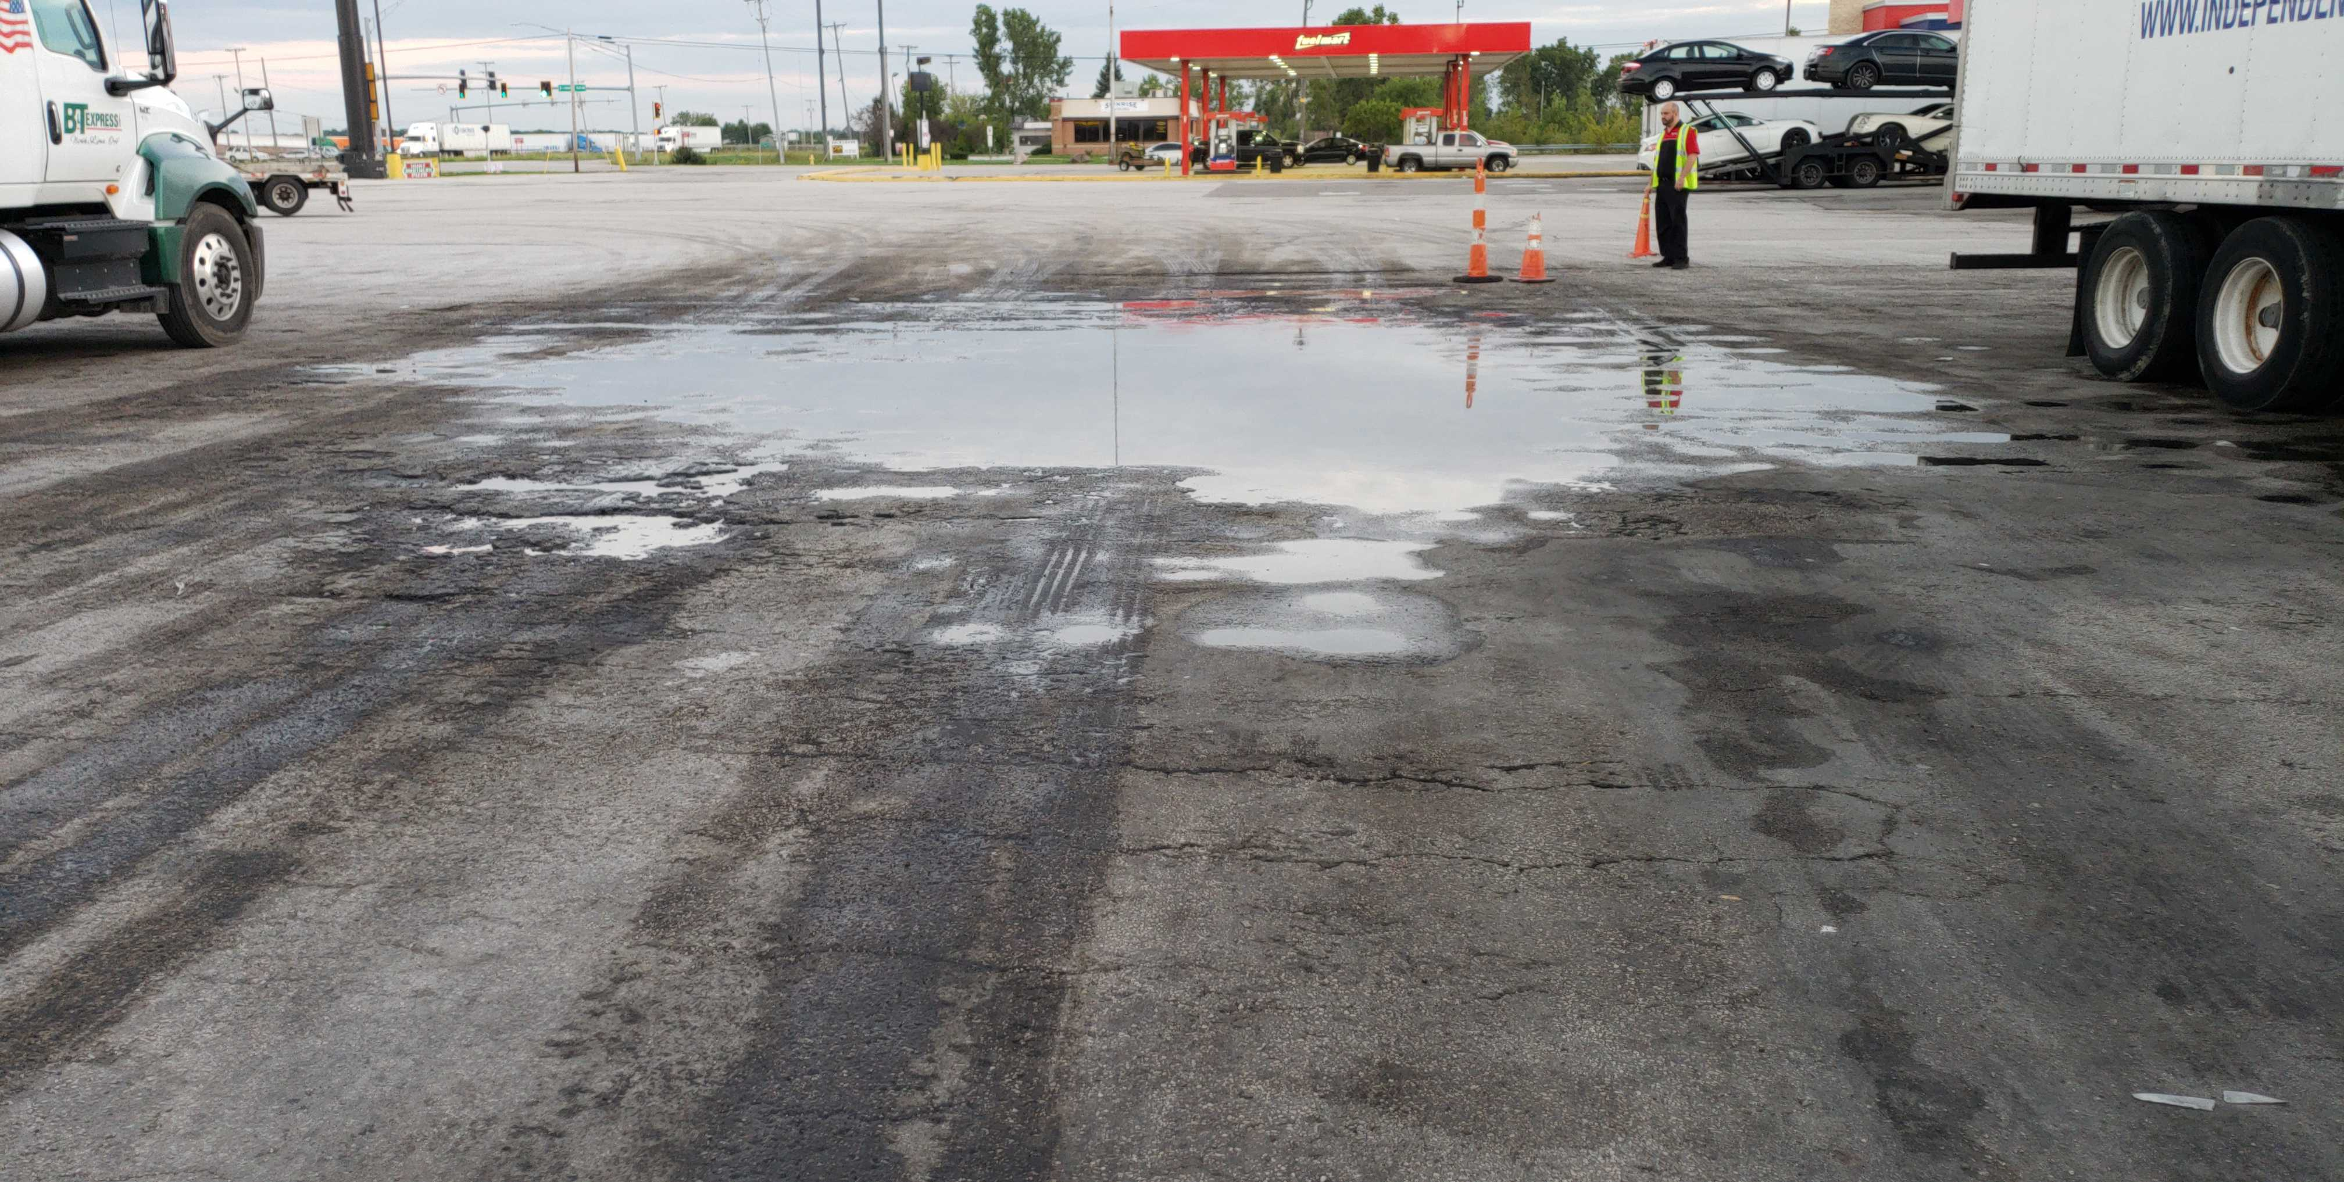
1. Company Policy – Incident Reporting 2. Incident Photos – taking the big picture to detailed information 3. Obtaining driver and company information
Feb. 2019 Review of Previous Meeting minutes:

Slide 3
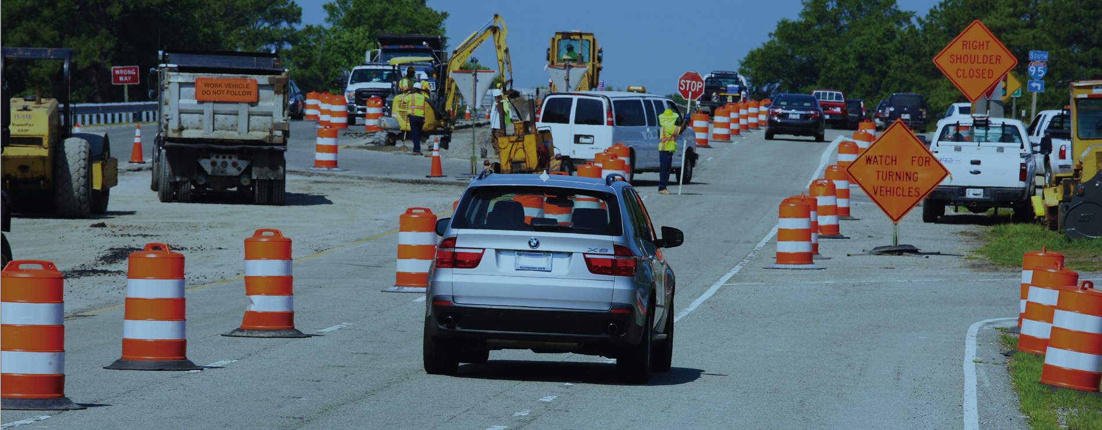
Drive Like You Work Here

Slide 4
Work Zone Safety

Slide 5
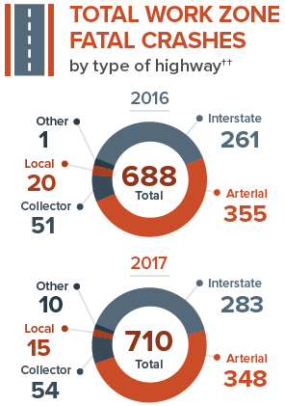
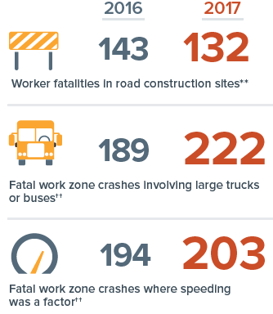
Drive Like You Work Here

Slide 6
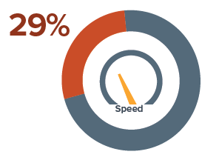
Speed and Safety in Work Zones
Speed is a contributing factor in almost 29 percent of 2017 fatal work zone crashes
Slow down and proceed with caution whenever you see signs of highway work.

Slide 7
Safety Tips for Driving in Work Zones
Plan Ahead
Obey Road Crews and Signs
Slow Down
Move Over
Avoid Distractions
Watch for Sudden Stoppages
Watch for Large Vehicles

Slide 8
Incidents and Injuries From 02/20/2019 to 03/19/2019

Slide 9
Employee Injuries:
Last reported FM and Subway employee injury was on 01/29/19 – Subway employee sustained a burn to the arm from taking bread pan out of oven.

Slide 10
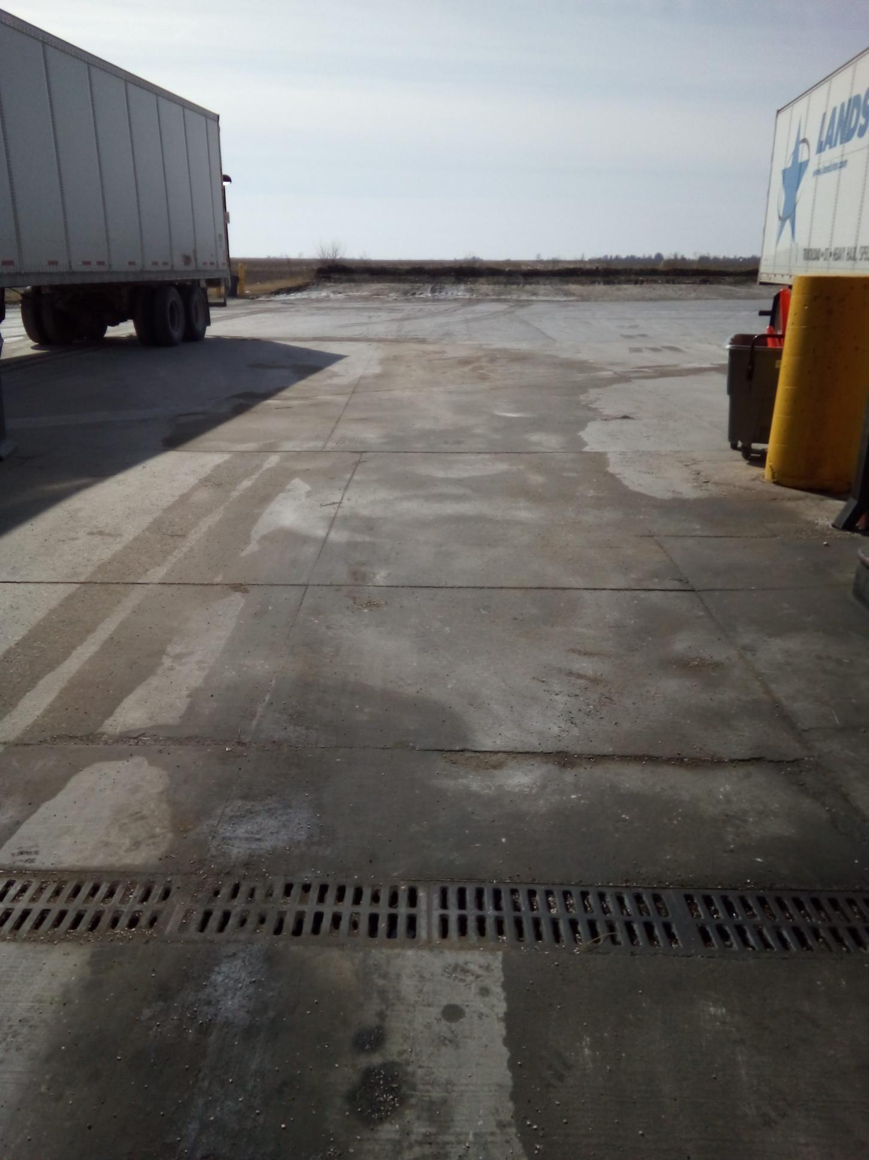
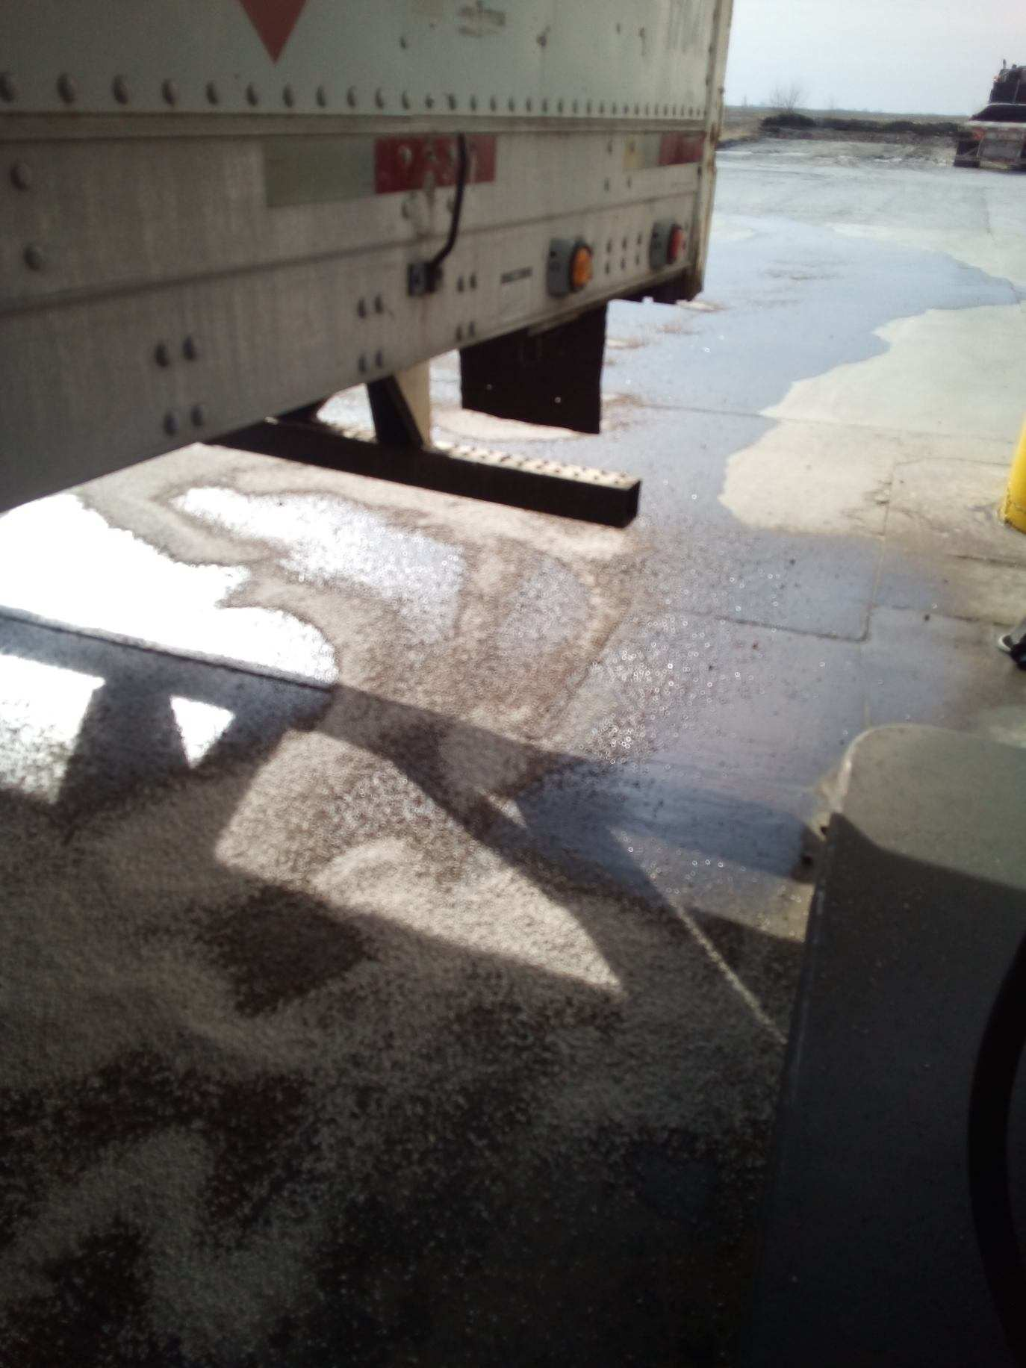
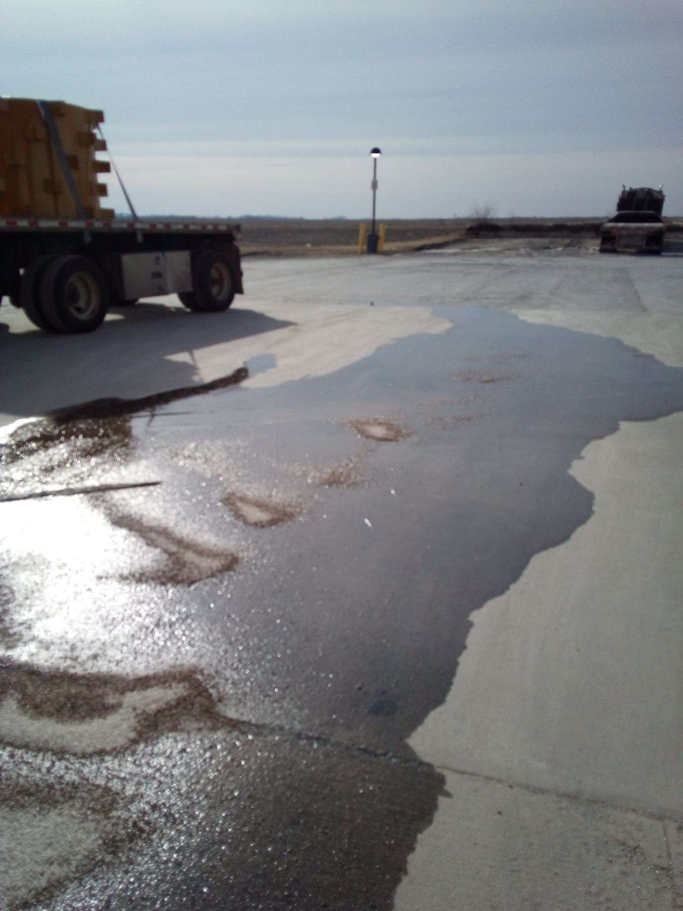
FM 787 diesel spill:
On 02/26/19 customer filling both fuel tanks on semi and the satellite fuel nozzle fell out continuing to flow product on the ground until the customer turned the pump off. Approx. diesel spill 10 - 20 gallons.

Slide 11
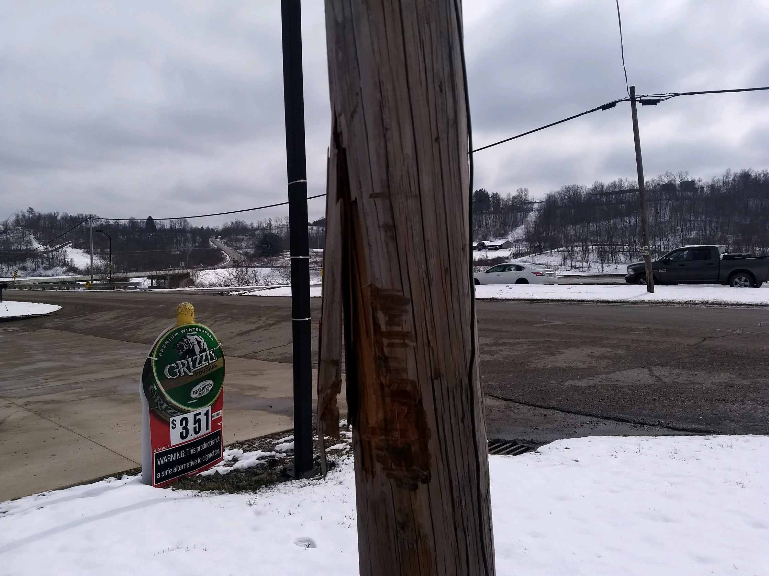
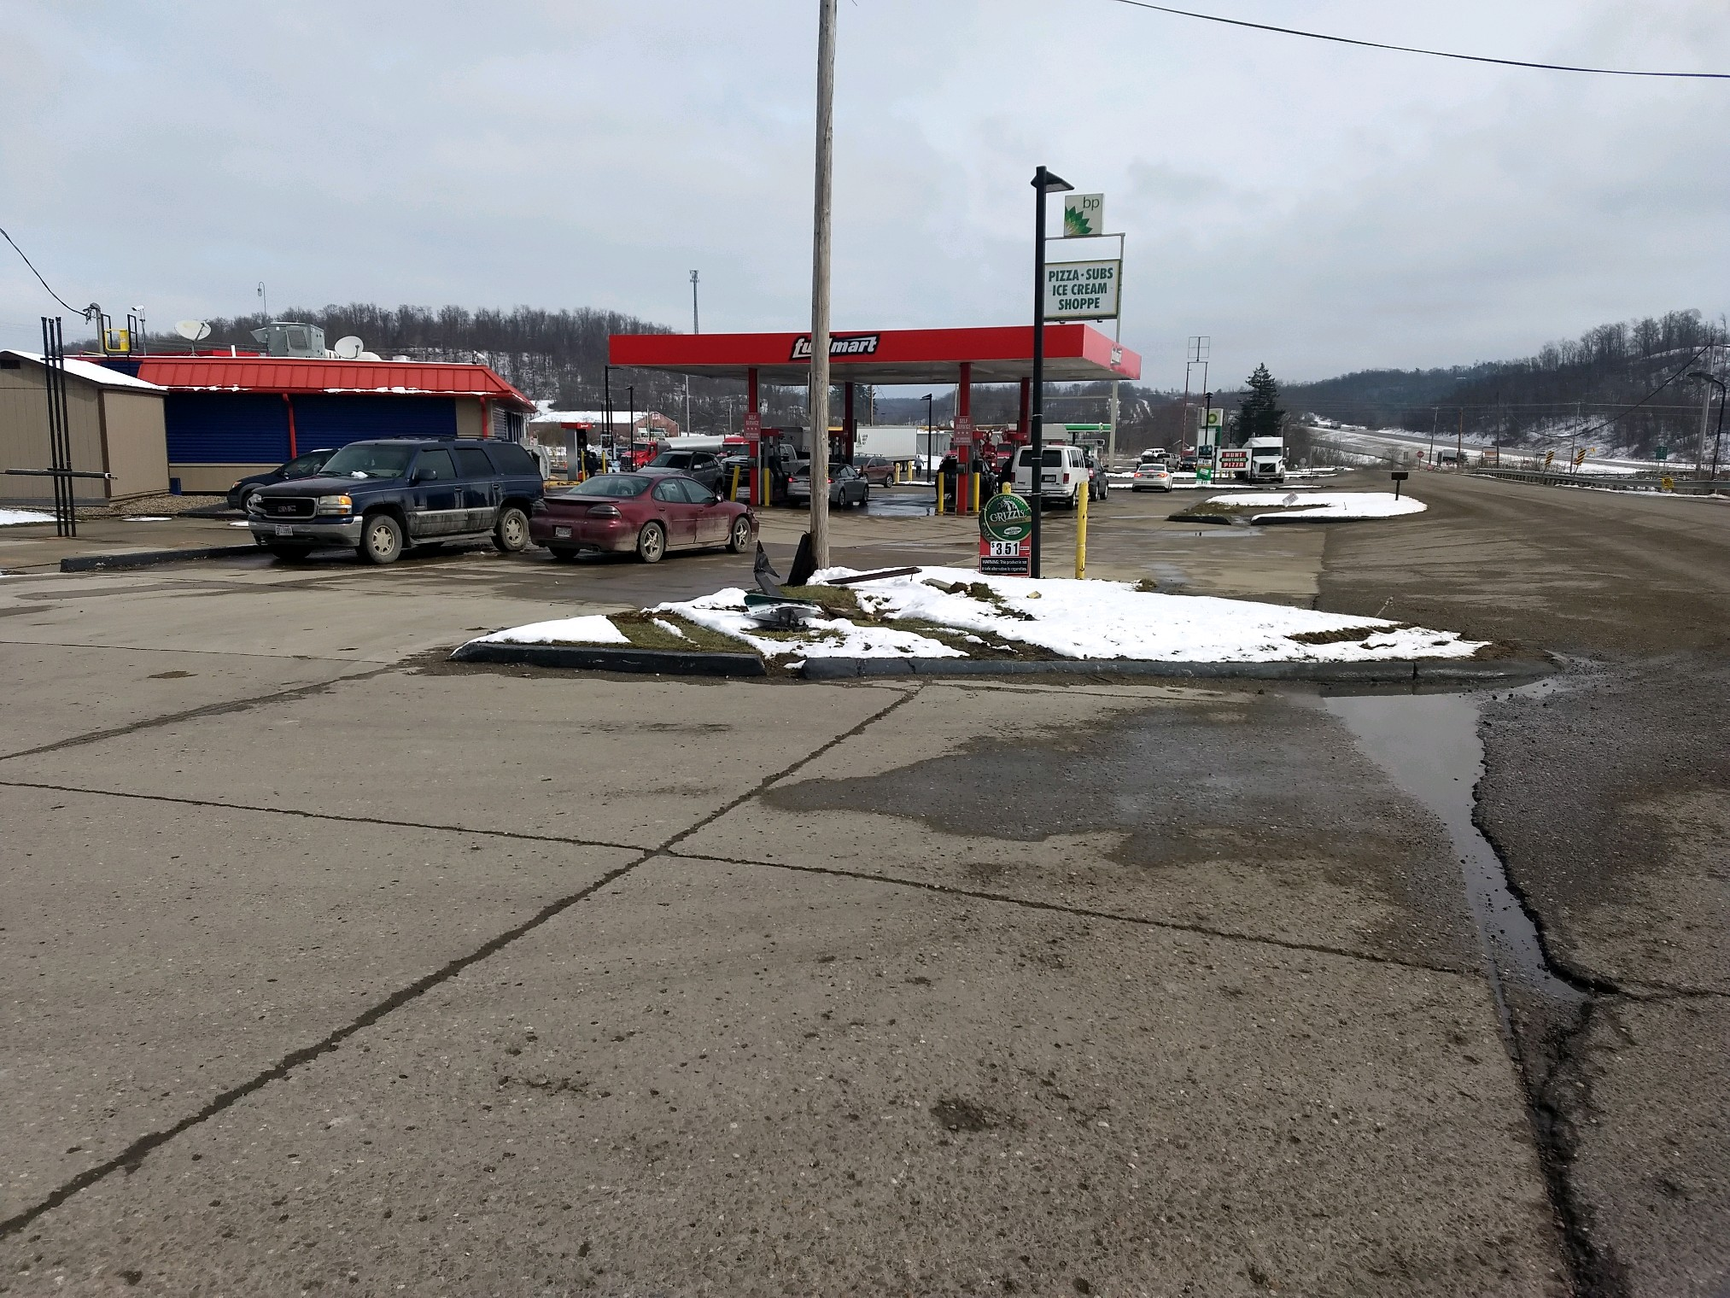
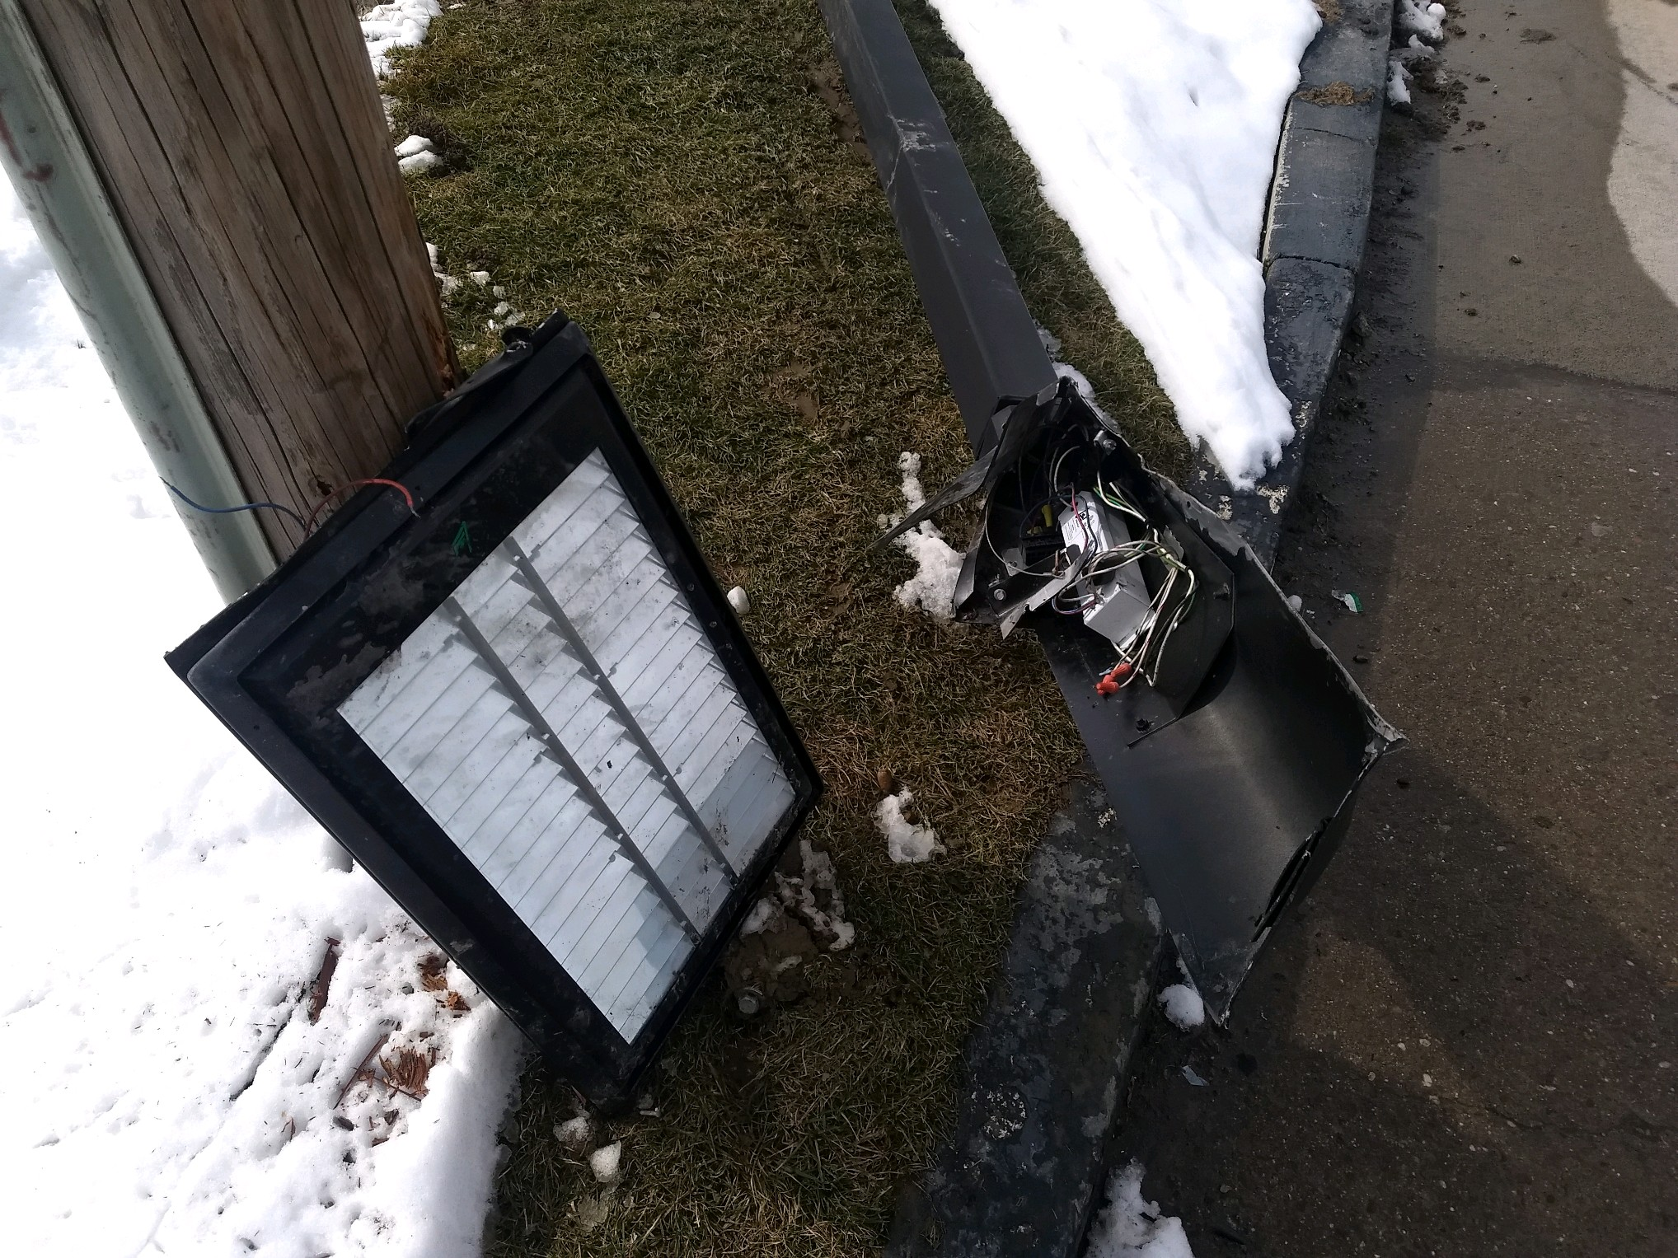
FM 727 FM Property Damage:
On 03/01/19 individual ran over the curb and drove through the grass and struck and destroyed the parking lot metal light post, horse hitching post and struck a telephone pole. Driver drove off.

Slide 12
FM customer slip and Fall:
On 03/11/19 the corporate office received a FM customer complaint. The FM camera system captured the customer getting out of the vehicle; taking a couple steps and fell. The customer had a conversation with the cashier about how he fell and how icy it is outside. The cashier did not fill out an incident report. The cashier did not report it to management. We do not think the customer was injured but called the corporate office to complain about the FM employee as he did not believe his concern was being taken seriously or addressed at the store.

Slide 13
Date Range: Jan. 01, 2019 – March 19, 2019 FuelMart & Subway Total Incidents: 23 (averaging 2 incidents per week in 2019) FuelMart & Subway employee injuries Reported: 6 FuelMart Property Damage and/or Vehicle Incidents: 5 FuelMart Customer Spills: 5 (3 at fuel pumps) FuelMart & Subway Customer injuries reported: 4 Other Incidents: 3

Slide 14
Open Floor Safety Questions / Concerns
Next Safety Committee Meeting is Wednesday, April 17, 2019 at 2:00 PM Eastern

Slide 15
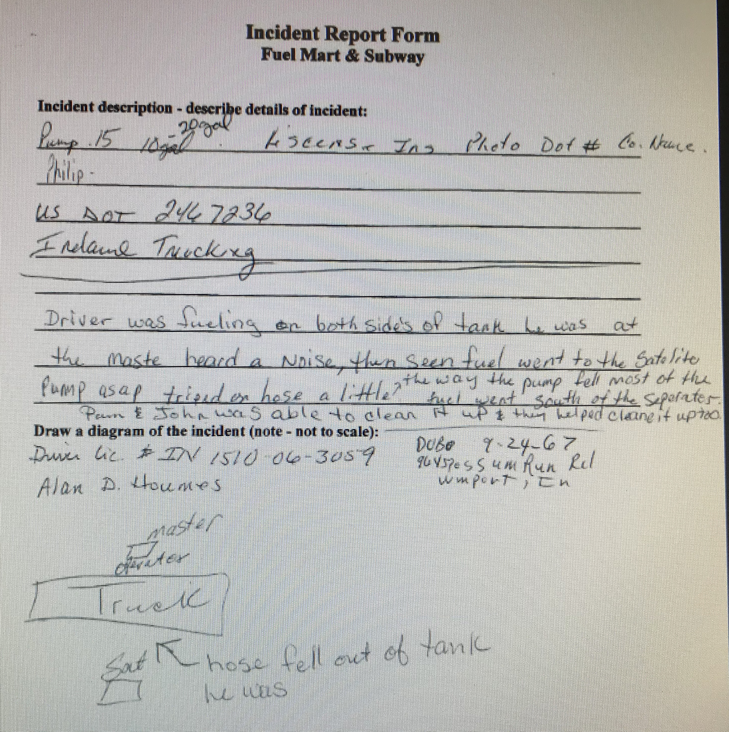
Jan. 2019 safety topic – completing incident reports.
Please ensure you complete each section that is applicable.
One reported spill had no customer information even though FM spoke to the customer, no photos taken of vehicle or of the spill, etc. Only the 3rd page of the incident report was sent.
Incident forms are used by:
Safety Dept, Pat C., Joel, Haley, etc.
Insurance (Ports Petroleum insurance and 3rd party insurance)
Law Firms (lawyers)

Slide 16
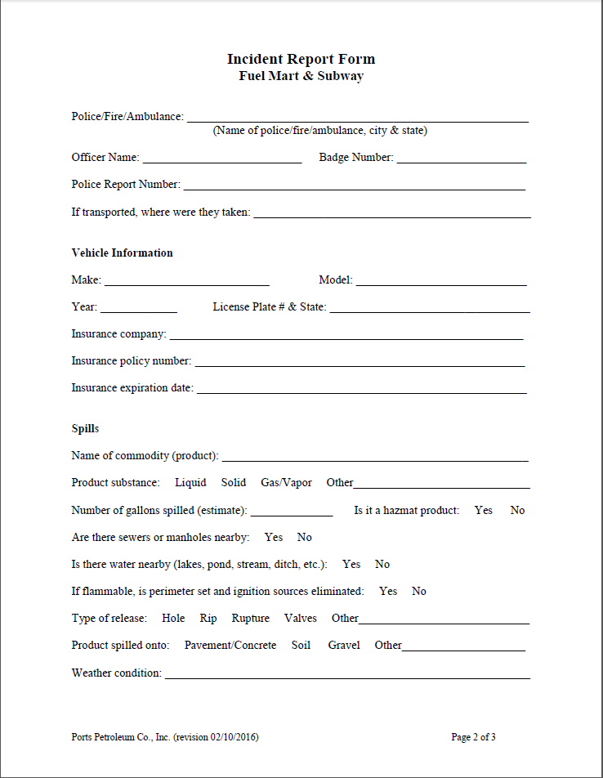

Slide 18
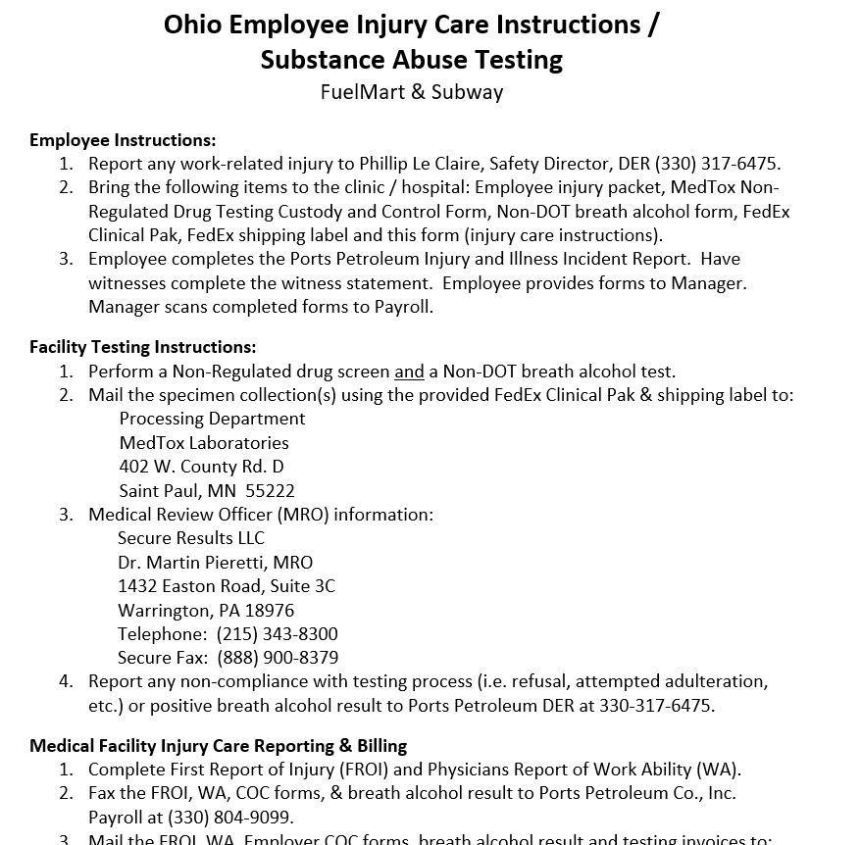
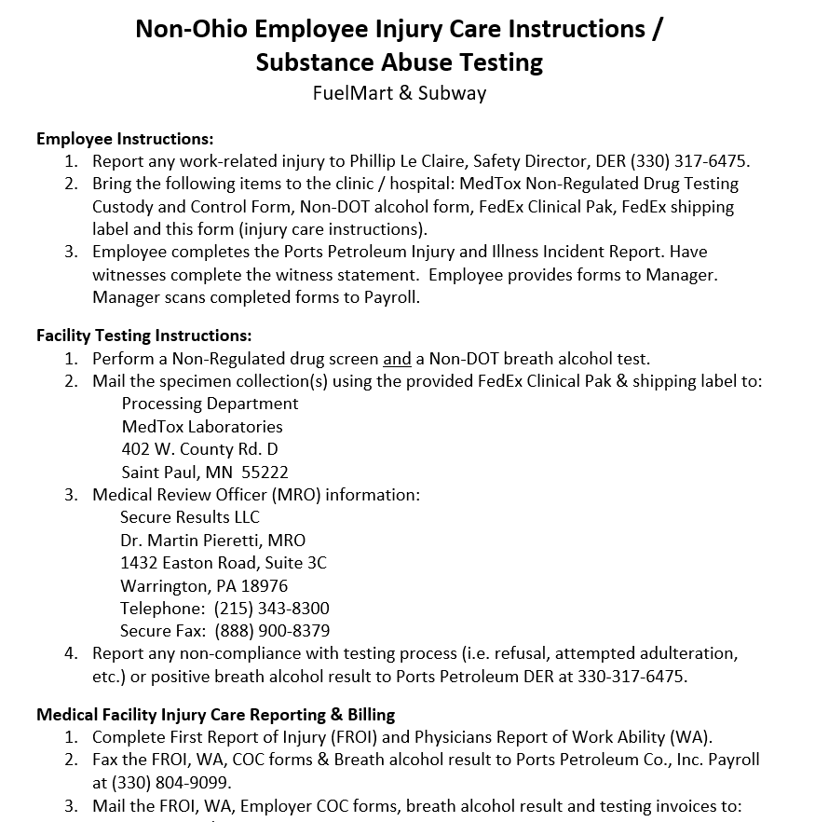
Updated Forms – Injury packets,
revision date 03/19/2019

